Slide 1
COS 301 & DVT Kinder Finder
Uteshlen Nadesan 28163304 Team Leader
Michael Johnston 12053300 Lead Programmer
Po-Han Chiu (Arthur) 11063612 Psychological Counsellor

Slide 2
DVT
Software development company
Specialising in mobile application development for firms and companies
E.g.
Price Check app
Standard bank tablet app
Vodacom/MTN tracking app
Located in Hyde Park, JHB

Slide 3
Kinder Finder A Vision
Many restaurants aim to give parents a worry free dining experience
However, a parent still has the worry
They have a consistent need to ensure their children are still in the safe and designated areas
This solution will attempt to assist the parents in being able to make sure their children are still in these areas without the need to get up from their tables

Slide 4
What is Kinder Finder
Using RFID receivers and transmitters to track the whereabouts of children in an area
E.g. In a restaurant
Parents (of the children) are able to track their child’s location via
Smart phone
Table map (optional)

Slide 5
Kinder Finder
Web Administration
Basic Reporting
Statistics
Zone use
Errors
Mobile Application
Web API
Embedded Hardware and prototyping (POC).
Nice-to-have (unless we finish implementation early)

Slide 6
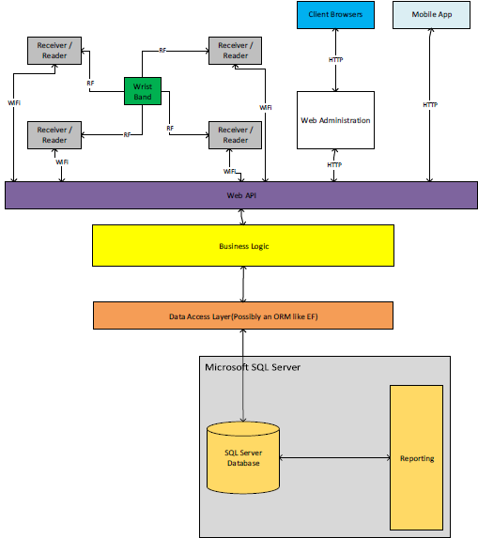

Slide 7
Technologies
Programming Language (Primary)
C#
Database
SQL Server Express 2012
Data Access Layer
Entity Framework (ORM)

Slide 8
Technologies
Web Development
ASP.Net MVC 5
WebAPI 2.2
IDEs
Microsoft Visual Studio 2013 Professional
Xamarin Studio

Slide 9
Demo User Details
Administration Portal
Username: admin
Password: Password1!
Android App
Email Address: test@example.com
Password: computer

